Slide 1

"Secure Storage Solutions: Protecting User Password Keys at Rest"
-Presented by:
Prashansa Priya

Slide 2
Agenda:
Problem Statement
Features Offered
Architecture Diagram
Technologies Used
Conclusion

Slide 3
Problem Statement: The problem statement "Protecting User Password Keys at Rest (on the Disk)" typically refers to the challenge of securely storing and managing sensitive user information, specifically passwords and cryptographic keys, on storage devices such as hard disks. Here’s a brief overview of the key concerns and solutions related to this problem::
1. Data Sensitivity: User passwords and cryptographic keys are sensitive information that, if exposed, can lead to unauthorized access and compromise of systems and user accounts.
2. Encryption: Encrypting user passwords and keys before storing them on disk is crucial. Encryption ensures that even if unauthorized access occurs, the data remains unreadable without the decryption key. 3.Key Management: Proper key management practices involve securely storing encryption keys separately from the encrypted data. This separation prevents unauthorized parties from easily decrypting the data, even if they gain access to the storage medium.

Slide 4
Features Offered:
The project provides several features to securely encrypt and decrypt files using a graphical user interface (GUI) built with Tkinter. Here is a detailed overview of the features offered:
File Selection:
Feature: Select a file to encrypt or decrypt.
Implementation: A file dialog allows users to choose a file from their filesystem.
Encryption:
Encrypt Selected Files: Users can select a file and encrypt it using a secure passphrase.
File Encryption Key (FEK): A randomly generated FEK is used to encrypt the file, and it is further encrypted with a key derived from the user's passphrase.
AES-GCM Encryption: Utilizes AES in Galois/Counter Mode for secure encryption.
Decryption:
Decrypt Selected Files: Users can decrypt previously encrypted files by providing the correct passphrase.
Key Derivation: Derives the decryption key from the passphrase to decrypt the FEK and the file.
AES-GCM Decryption: Ensures data integrity and authenticity during decryption.

Slide 5
Features Offered:
User Interface (UI):
Tkinter GUI: Provides a user-friendly graphical interface for file selection, encryption, and decryption.
Security Features:
Passphrase Protection: Encrypts and decrypts files using a passphrase-derived key.
Random Key Generation: Generates random salts and FEKs for each encryption process to ensure unique encryption.
Error Handling:
User Feedback: Provides warnings and error messages for issues like missing files or incorrect passphrases.

Slide 6
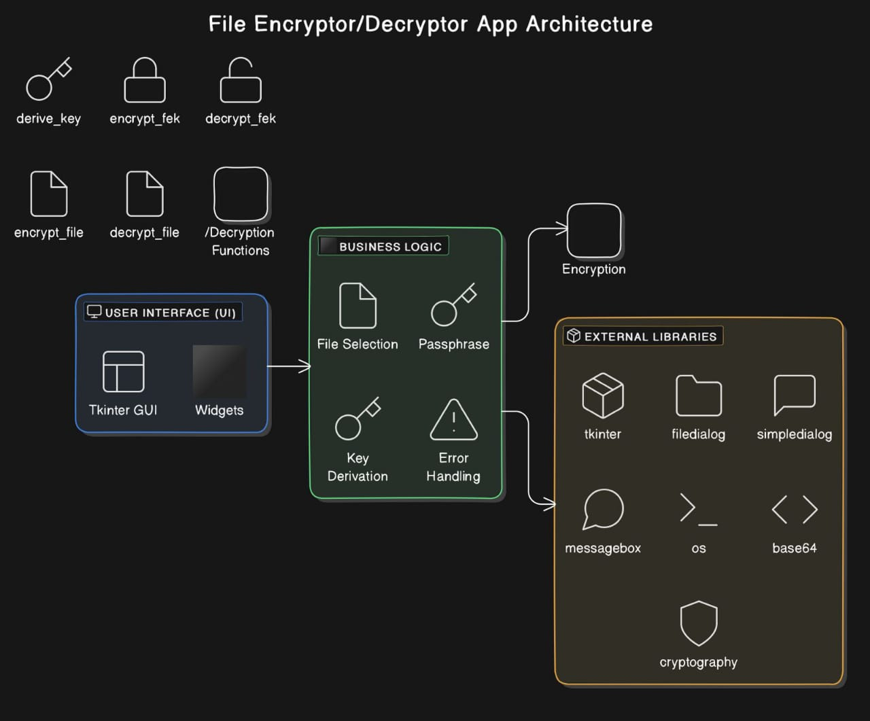
Architecture Diagram:

Slide 7
Technologies Used: For the project "Protecting User Password Keys at Rest," the technologies used include:
Programming Language: Python Python is used in this project to implement the functionality for encrypting and decrypting files, creating ZIP archives, and providing a graphical user interface (GUI).
Libraries: 1.tkinter :Used for creating graphical user interface(GUI), including file dialogs , input dialogs and message boxes. 2. ‘OS’: used for generating random bytes (for salt and IV) and for handling file paths. 3. ‘base64’: used for encoding and decoding data to and from base64 , which is often used for storing binary data in a text format. 4. ‘cryptography’ : ‘cryptography.hazmat.primitives.kdf.pbkdf2.PBKDF2HMAC’ Used for key derivation, to derive a key from a passphrase using PBKDF2 with HMAC and SHA-256. ‘cryptography.hazmat.primitives.ciphers.Cipher’ : Used to create cipher objects for encryption and decryption

Slide 8
Technologies Used:
Integrated Development Environments (IDEs):
Visual Studio Code: A popular, lightweight, and versatile code editor with support for Python and various extensions that enhance productivity.
Crypto Algorithms: The script uses the Advanced Encryption Standard (AES) algorithm in Galois/Counter Mode (GCM) for both the encryption and decryption of the file and the File Encryption Key (FEK). Here are the details: 1.Key Derivation Function (KDF): .Algorithm: PBKDF2 (Password-Based Key Derivation Function 2) with HMAC-SHA256. .Purpose: Derives a cryptographic key from a passphrase using salt and multiple iterations((100,000 in this case). 2. File Encryption Key (FEK) Encryption/Decryption:
.Algorithm: AES-GCM (AES in Galois/Counter Mode).
.Key Size: 256 bits (derived from the passphrase).
.Initialization Vector (IV): 16 bytes (randomly generated for each encryption operation).
.Authentication Tag: Used by GCM mode for ensuring data integrity and authenticity.

Slide 9
Conclusion:
This project successfully implements a secure file encryption and decryption application using Python and the Tkinter library for the user interface. It addresses the critical need for protecting user files and encryption keys through the following key steps:
Key Derivation:
The application uses the PBKDF2 algorithm with SHA-256 to derive a secure key from a user-provided passphrase. This ensures that the encryption key is both unique and difficult to guess.
File Encryption Key (FEK) Handling:
A random FEK is generated and encrypted using the derived key. This encrypted FEK is stored separately, enhancing the security of the overall encryption process.
File Encryption:
The selected file is encrypted using the AES-256-GCM algorithm. This provides strong encryption along with integrity checks, ensuring that the file contents cannot be tampered with or accessed by unauthorized users.
File Decryption:
The encrypted file is decrypted using the FEK, which is retrieved by decrypting the stored encrypted FEK with the user's passphrase-derived key. This process ensures that only authorized users with the correct passphrase can decrypt and access the file.
The project not only demonstrates the application of cryptographic principles but also provides a user-friendly interface for encryption and decryption tasks, making it practical for everyday use. By adhering to the guidelines outlined in the provided problem statement, the project effectively meets the requirements of protecting user password keys at rest on the disk.

